Slide 1
iPiezo?
the piezoelectric effect as an alternative energy source?

Slide 2

Engage
Students will each be given a wintergreen life saver. As a class we will enter a room where the lights can be turned off and a dark environment provided. (Strict rules for safety and behavior will be discussed) The students will work in pairs. One students will watch as the other student bites into the Lifesaver. Then they will switch.
The student who is watching should see a spark in the mouth of the student biting into the Lifesaver.

Slide 3

https://www.youtube.com/watch?v=orpU1CnUyRA

Slide 4
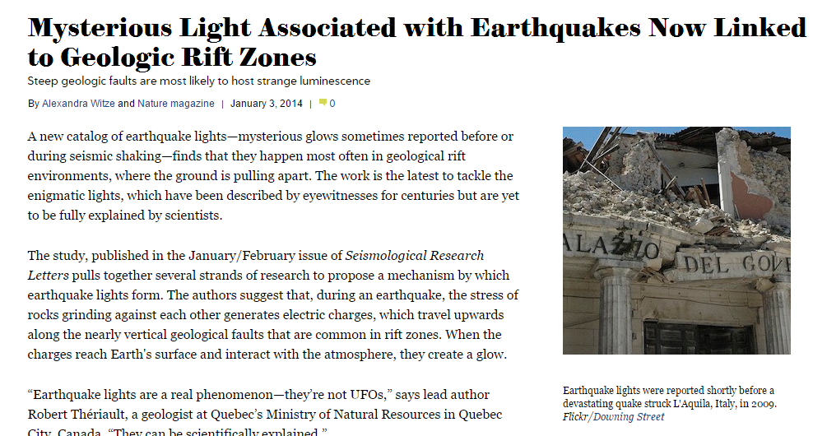
Upon returning to the classroom we will have a discussion about what could cause this phenomenon. Before answering completely, I will present the students with the following article: http://www.scientificamerican.com/article/mysterious-light-associated-earthquakes/
UFO Sighting Reports increase dramatically during Earthquakes.
Strange light effects can occur starting weeks before an Earthquake and continue until the seismic activity has passed.
These light effects have been attributed to pressure and distortion of rocks.

Slide 5
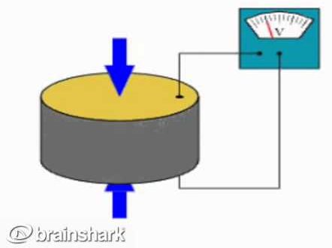
Explain:
What is the Piezoelectric Effect?
Piezoelectric Effect is the ability of certain materials to generate an electric charge in response to applied mechanical stress. The word Piezoelectric is derived from the Greek piezein, which means to squeeze or press, and piezo, which is Greek for “push”.

Slide 6
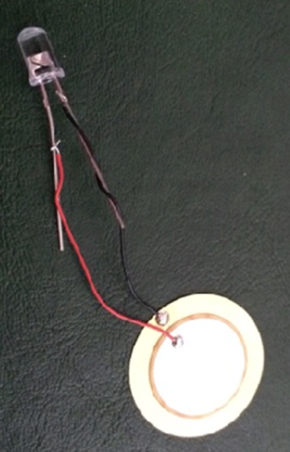
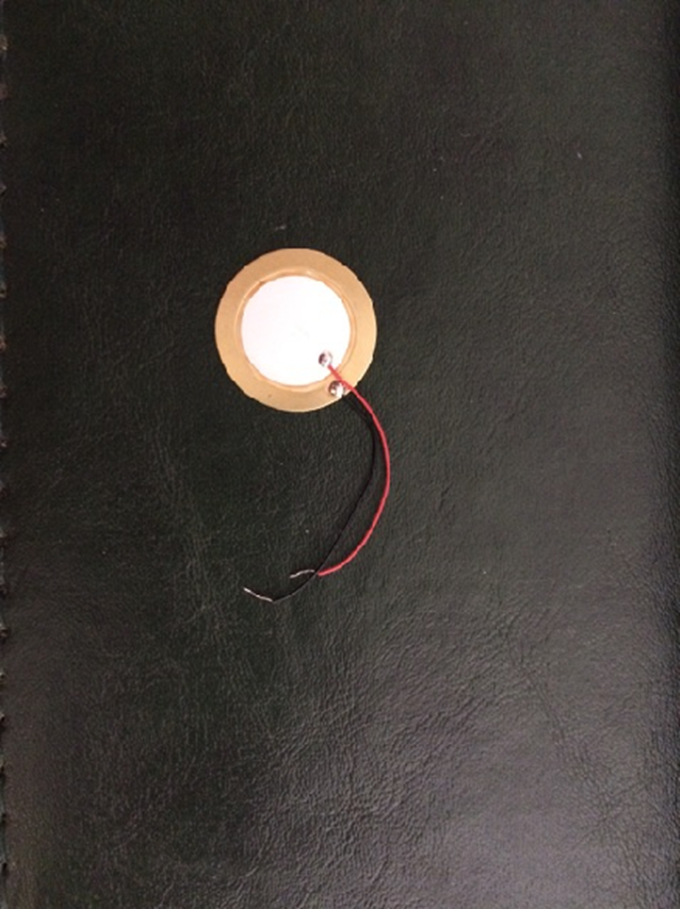
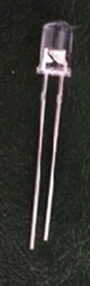
Can these supplies be used to show the piezoelectric effect in action?
=
Piezoelectric Element
“Guitar Pickup”
LED
Light Emitting Diode

Slide 7
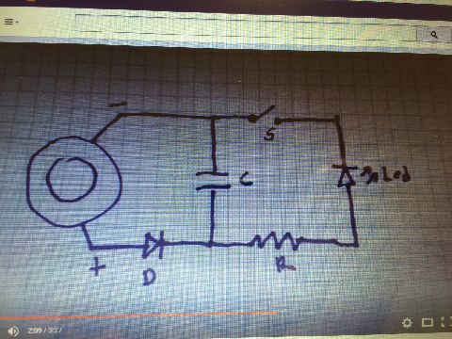
Explore: Can we harness the energy created by the piezoelectric effect?

Slide 8
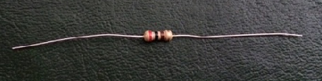
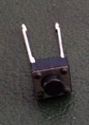
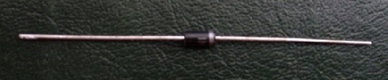
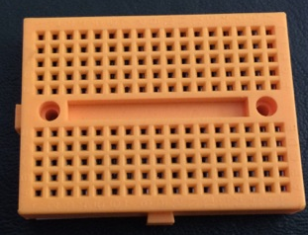
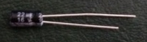
Supplies Needed:
Resistor: reduces current flow and acts to lower voltage levels within circuit
Switch: Controls the flow of energy
LED: Lights up when switch is turned on to show energy flow
Diode: keeps flow moving in one direction
Beadboard: Allows for safe and easy connection of circuit componants
Capacitor: stores and releases energy
Piezo element: distortion of this provided energy for the circuit

Slide 9
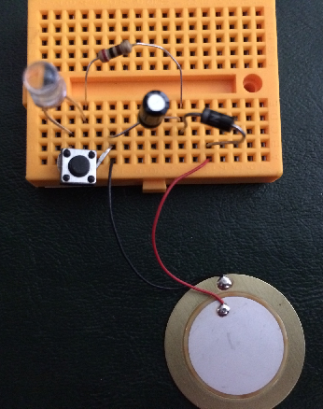
Set up the circuit according to the diagram:

Slide 10
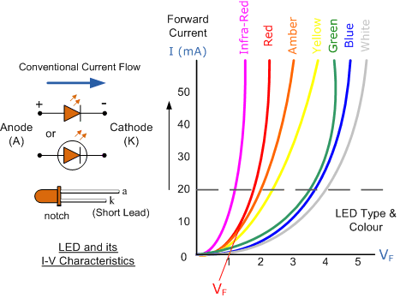
Evaluate:
Which group can make their LED light for the longest period of time?
Ideas that will not be shared with the students until after they have explored options on their own:
Experiment with different ways to distort piezo
Add more piezo elements.
Use a color of LED that requires less energy
Use various sized Capacitor

Slide 11
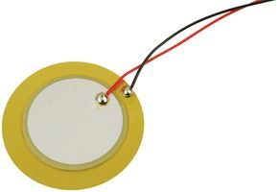
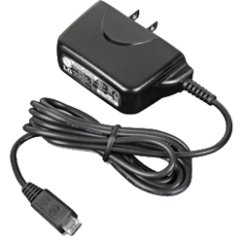
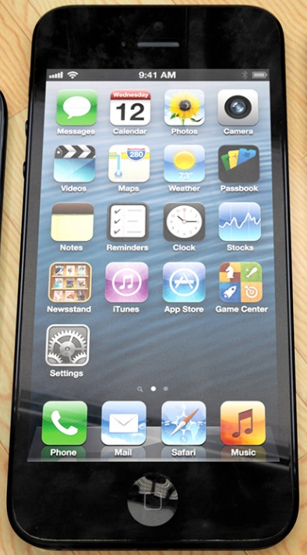
Can this type of circuit be used to charge a cell phone?
iPiezo?

Slide 12
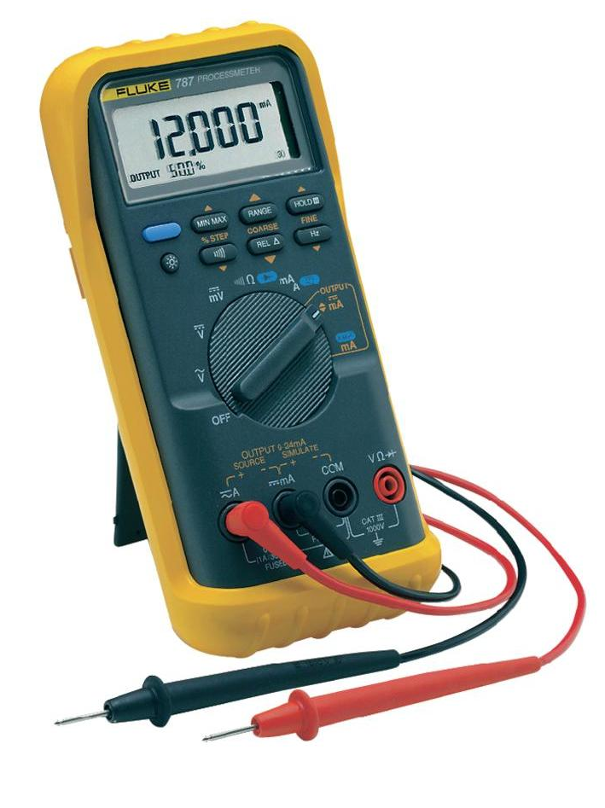
In order to calculate how much energy is being generated we would need to use a multimeter to measure the amount of energy contained in the capacitor and the amount added with each push of the element.
Notes:
Image source: (lightning bolt) Microsoft clipart at http://office.microsoft.com/en-us/images/results.aspx?qu=lightning&ex=1#ai:MC900441735|

Slide 13

Example of calculations:
The energy stored in a capacitor is given by the equation:
$$E= \frac{1}{2}V^{2}C$$
If in our circuit, C = 220 µF. When the multimeter shows 10 volts across the capacitor, the amount of energy stored is
$$E= \frac{1}{2}{\left(10 V\right)}^{2}\left(220 μF\right)=0.011 joules$$
If a single tap on the piezoelectric element increases the voltage from 2 V to 2.05 V, the amount of energy generated for each tap is
$$E= \frac{1}{2}{(2.05}^{2}−2^{2})(220 μF)=0.000022 joules/tap$$

Slide 14
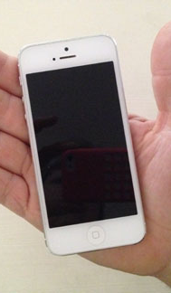
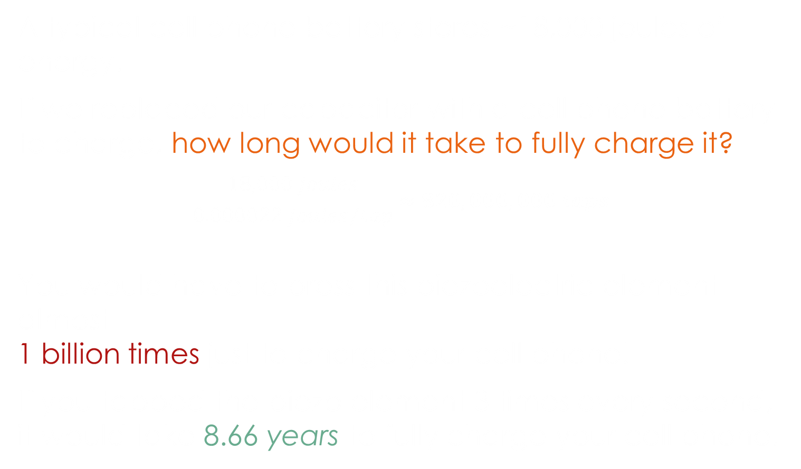
How Much energy is 0.000022 Joules?
A typical cell phone battery stores ~18,000 joules of energy.
If we replaced our capacitor with a cell phone battery to charge, how long would it take to fully charge it?
$$\frac{18,000 joules}{0.000022 joules/tap}≈820,000,000 taps$$
You would have to press this piezoelectric element almost
1 billion times just to charge your cell phone!
If you tapped the piezo element 3 times every second,
it would take 8.66 years to fully charge your cell phone.
Notes:
Image source: 2014 Denise W. Carlson, ITL Program, College of Engineering, University of Colorado Boulder

Slide 15
Extension:
Research how piezoelectric technology is being developed as an alternative energy source?
Develop your own idea for something that can be powered by the piezoelectric effect.
Create a diagram for how it will work.
Be prepared to share both with the class.

Slide 16
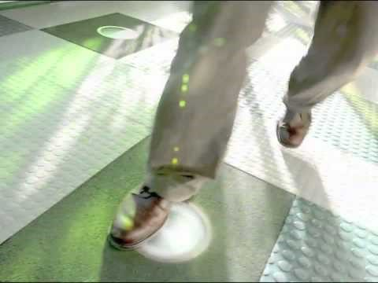
Generating energy from footsteps at a busy school

Slide 17
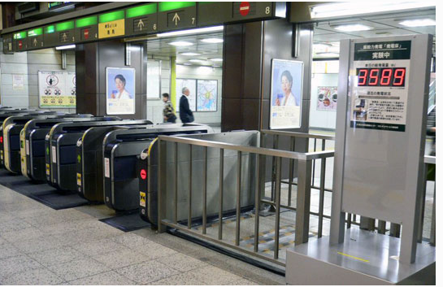
Energy-Generating Floors to Power Tokyo Subways

Slide 18
More Piezo Technology:
History of Piezo: SONAR, smoke alarms, Surface Acoustic Wave filter devices, sonobuoy, Piezo ignition systems, microphones
Electricity generated by roads as cars pass over
Chin Strap that makes energy from chewing
Tires that make energy each time they contact the road
Energy Harvested from Touch Screens

Slide 19
Links for articles:
http://www.piezo.com/tech4history.html
http://www.gizmag.com/piezoelectric-road-harvests-traffic-energy-to-generate-electricity/10568/pictures
http://www.gizmag.com/piezoelectric-chin-strap-electricty/33885/
http://www.gizmag.com/goodyear-bho3-electric-tire/36548/

