Slide 1


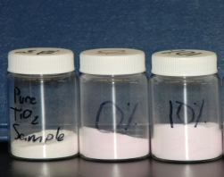
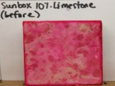
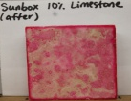
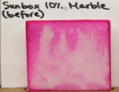
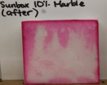
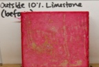
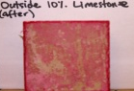
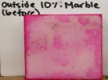
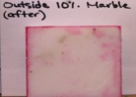


FMRI RET 2015- Poly(carbonate urethane) and
doped Titania coatings for Cultural Heritage preservation
Gwendolyn Martin-Apostolatos¹, Venkat Bhethanabotla²: Vignesh Bhethanabotla²
1. Jefferson High School; 2. Chemical Engineering, University of South Florida
Abstract
Approach
Conclusions
A poly(carbonate urethane) coating composed of Idrocap 993PF and Titanium dioxide doped with Erbium and Ytterbium was prepared via sonication. This was done to evaluate its possible use as a coating for stone surfaces in cultural heritage preservation and rehabilitation. Limestone and marble samples were used for testing as stones typical of heritage sites. The coating was tested for its photocatalytic properties using rose bengal degradation in response to simulated and natural sunlight. Rock surfaces were monitored for changes in morphology and color after treatment to determine if the coating would be suitable for preserving the aesthetic quality of heritage sites. The properties assessed indicate that the coating tested could be suitable for use in the preservation of stone structure heritage sites.
The photocatalyst samples (fig. 1) used had been prepared using a modified hydrothermal synthesis method for TiO₂. The photocatalysts were synthesized with erbium nitrate and ytterbium nitrate as the sources for the Er³⁺ and Yb³⁺ ions. Three synthesized samples were used differing in their percent of TiO₂, Er, and Yb. The composition of the samples in molar percent are: 100% TiO₂, 98% TiO₂ 2% Er 88%, and TiO₂ 2% Er 10% Yb, 83%.
The results showed that the coatings tested have potential for use in heritage preservation endeavors. The main criteria that was evaluated falls into three areas: the aesthetic impact of the coatings on stone samples, the photocatalytic quality of the doped Titania in simulated sunlight (figure 6), and the impact of humidity on the reaction of the coatings with regards to dye degradation.
There is little to no impact on the aesthetic quality of the stone samples making these coatings appropriate for use on cultural heritage sites.
Furthermore, when referring to the figure 6, it can be seen that the coating with the most impact was the 10% coating (4). The coating is more effective with the less porous marble samples but still makes a difference on the limestone.
The visible differences of the reactions in low versus high humidity (when low humidity samples reacted for 20 hours and the high humidity samples reacted for only 6 hours) suggests that higher humidity leads to faster reaction times. This would make the coating beneficial to outdoor heritage sites, especially in high humidity areas such as Florida where the outdoor test were conducted.
Overall the use of doped titania coatings show promising initial results. Further testing will be done to determine the specific differences between the coatings including the reaction with UV versus visible and infrared light. Further testing should also be conducted to determine the effects of the coatings on spalling as well as the long term durability of the material. Outdoor samples will have to be analyzed for quantitative differences in dye degradation.
figure 1
The coating was prepared using a commercial poly(carbonate urethane), Idrocap 993PF, and cold mixing it with 1% of the photocatalyst samples via sonication. 25mL of the coating was then brushed evenly onto the surfaces of both travertine limestone samples and white marble samples. The stone samples dried within an hour allowing the aesthetic impact of the coating to be evaluated.
The coating was transparent and did not change the color of the stone. The only noticeable difference was a slight sheen which could be seen only when the stone was hit by light at certain angles. The TiO₂ particles could be seen using a magnifying glass but, due to the natural grained appearance of stone, had negligible impact of the aesthetic quality of the stone surface.
Once the coating had dried some of the samples were treated with rose bengal dye representative of contaminants in the environment. Both limestone and marble samples were set up using the following coatings: Idrocap 993PF only, Idrocap plus 1% of pure TiO₂ , Idrocap plus 1% of 98% TiO₂ 2% Er 88% (labeled 0%), and Idrocap plus 1% of TiO₂ 2% Er 10% Yb, 83% (labeled 10%). Once treated with the dye half of the samples were exposed to simulated sunlight in low humidity for 20 hours while the other half were exposed to natural sunlight outdoors for 6 hours with an average humidity of 60%. Before and after exposure pictures were taken of all the samples. The degradation of the dye for the simulated sunlight (sunbox) samples were analyzed using the NIH program Image J.
The outdoor samples were only able to be analyzed for the visible differences at this time, although the contrast between the low and high humidity samples are readily apparent as can be seen in figures 2-5.
Background
Stone heritage sites are under constant assault from a variety of assailants including weathering, pollution, and climate change. With so many factors to account for, efforts to preserve and rehabilitate these structures are met with complex challenges. Protective and self-cleaning coatings offer a possible solution to some of the problems faced in the field of cultural heritage preservation but these coatings must fulfill certain criteria. A coating cannot impact the aesthetic quality of a structure, it must be easy to apply to the stone surfaces, the coating should protect the structure from new contaminants while having no harmful byproducts, it should repel water while at the same time allow water trapped below the surface to escape to minimize damage from spalling, and finally it should be durable and long lasting to maximize time between reapplications. The goal of this research was to test possible coatings for use on stone structure heritage sites to see if they met most or all of these criteria.
figure 6: 1) Idrocap only, 2) Pure, 3) 0%, 4) 10%
Objectives
figure 2: Simulated Sunlight on Limestone
figure 4: Simulated Sunlight on
Marble
Referenced Resources
.
-D'Orazio, L., & Grippo, A. (2014). A water dispersed Titanium dioxide/poly(carbonate urethane)nanocomposite for protecting cultural heritage: Preparation and properties. Progress in Oragnic Coatings, 79, 1-7.
-La Russa, M., Ruffolo, S., Rovella, N., Belfiore, C., Palermo, A., Guzzi, M., & Crisci, G. (2012). Multifunctional TiO2 coatings for Cultural Heritage. Progress in Organic Coatings, 74, 186-191.
-Watt, J., Tidblad, J., Kucera, V., & Hamilton, R. (2009). The Effects of Air Pollution on Cultural Heritage. New York: Springer Science.
Recreate previous research in titania coatings, create new coatings, and test the results on actual rock samples
Address concerns about coating use on American heritage sites
Evaluate coatings for practical use on stone structure heritage sites
figure 3: Natural Sunlight on Limestone
figure 5: Natural Sunlight on
Marble
For more information about the program visit: http://fmri-ret.eng.usf.edu/. The Research Experience for Teachers (RET) at the Functional Materials Research Institute at USF is funded by the National Science Foundation under award number 1301054.

Slide 2
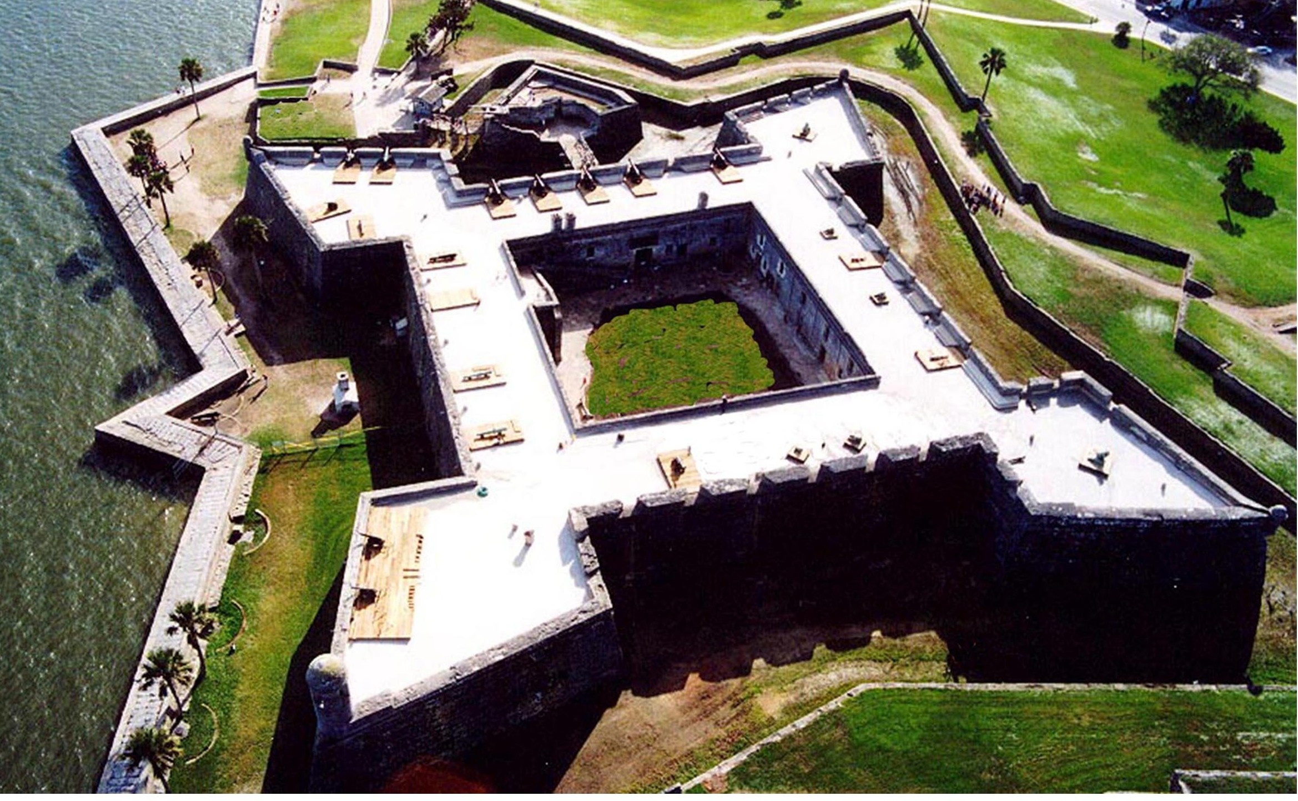
Thursday
You will be given a number and corresponding question for homework (#1-5) on your way out the door today. You have also been given a packet with background information important to the lab you will be participating in. You are asked to research the answers to the question you were assigned for tomorrow’s discussion. Please come in with a well constructed 1-2 paragraph answer.
INSTRUCTIONS – Complete the pre-assessment below. Please do this at noise level 0 as this should be just what YOU already know. This will only be graded for completion. Leave space below your answers for corrections. Hand your answers in to the class folder before you leave. You can work on beginning to read the lab background packet when you are finished. 1. What rocks and/or minerals are readily available in Florida for use in building structures? What rocks and/or minerals available in Florida were used in building structures in the past? Compare and contrast these materials. 2. Why are some materials more suitable than others in building structures? How can we identify the characteristics of rocks and minerals to evaluate their suitability for use as building material? 3. What is a cultural heritage site? What are the benefits of maintaining and preserving Florida’s heritage sites? 4. What building materials (in Florida) would you use to build something you wanted to last for hundreds of years? Why? 5. What problems might a structure encounter over time that leads to its deterioration? What are possible solutions to these problems?

Slide 3
ALWAYS WRITE THE OBJECTIVE AND ANSWER QUESTIONS IN FULL SENTENCES.
Friday
Objective: Students will be able to describe the ideal characteristics of rock based building materials with emphasis on longevity by participating in an interactive student led lecture and by reflecting on the answers to yesterday’s pre-assessment.
INSTRUCTIONS – Please go to one of the numbered groups that matches the question number you were assigned for homework the previous night (for example, #1 can go to 1A or 1B). Get out your information packet as well as your answer to yesterday’s question. Mrs. Martin will be walking around to give you credit for completing your homework.
Bellwork Have you ever been to a heritage site (a site of significance to human culture and history/prehistory)? a. If yes: what one? Where was it located and what can you tell us about your experience? b. If no: what site would you be interested in visiting and why? (this could be anywhere for example, a fort, a battlefield, a historical home, a location where an important event occurred…)
Notes:
HW check will also serve as attendance – BW time 5 minutes
5 min discussion about BW answers

Slide 4
National Heritage Site: Castillo de San Marcos Location: St. Augustine, Florida
Notes:
Students will watch a brief video (4 min) about the Castillo and then will be directed to example the rock pieces on their desks. As a group they will discuss, agree on, and write out a description of the material using rock identification terminology as best they can. ROUND ROBIN WRITE – 4 minutes… 2 minute class discussion sharing answers (rock sample is coquina, used to build the Castillo)

Slide 5
INSTRUCTIONS – Using your homework answers and any other material provided in the classroom: Discuss the answer you can up with to the HW question with your group Have an open discussion about your responses and attempt to refine and improve on the answer. Agree on a response as a group. (5 min max) Create a poster answering your question by highlighting key information. This should be a visual aid to help you explain your answer to the class. (Initial by your individual contribution to the poster) (10 min max) Put your poster up in its designated location. Once all groups in your section are ready you will present your poster to the other groups. This will continue until you have heard the responses to all 5 questions. When everyone is finished leave a post-it note on another groups poster – this can be used to ask a question, leave feedback, or compliment the work done. (10 min max – about 1 min per presentation, about 1.75 min for each presentation)
Notes:
Teacher will enforce time constraints and keep up a Kagan timer to let students know to keep things moving. There should be 10 groups in a class of 30 to make sure all students are engaged – the poster presenters will be separated into 1-5A and 1-5B and have presentations on opposite sides of the room.

Slide 6
INSTRUCTIONS – Go back to your desks. You will find yesterday’s pre-assessment there. Pack up except for this paper and a pen. USE A DIFFERENT COLORED PEN FROM YESTERDAY. Refine, correct, and add information to your answers from yesterday to demonstrate the knowledge you have gained. This will be today’s exit slip. In exchange you will receive your homework assignment. (Yes, you have weekend homework – I promise it won’t be terrible but it is important you complete this before you build you experiment proposal on Monday)
Notes:
Students should have at least 5 minutes to complete this. Teacher will collect posters as students head back to their seats so students do not rely on them for the answers.
HW (weekend assignment): Read the assigned article and answer the stop and reflect questions as you go. Using the article as a starting point find an outside resource to help solve the ADI problem listed on your information packet. You are encouraged to look for information on other heritage sites. Either bring it printed to class, easily useable on an electronic device that allows you to highlight, or message it to Mrs. Martin through Edsby (by 7am Monday morning).

Slide 7
ALWAYS WRITE THE OBJECTIVE AND ANSWER QUESTIONS IN FULL SENTENCES.
Monday
Objective: Students will research a problem and use this information to create experiment proposals in the effort to find the best cost effective and environmentally sustainable method for preserving rock based heritage structures.
INSTRUCTIONS – Please sit with your lab groups and get out your HW (unless you sent it through Edsby). You will also need your information packet and the ADI graphic organizer.
Bellwork What is the scientific method (list the steps or summarize) and why is it important when solving a problem? 2. Why is it important to preserve heritage sites? Give at least 2 examples.
Notes:
HW check will also serve as attendance – BW time 5 minutes
5 min discussion about BW answers

Slide 8
INSTRUCTIONS – You and your lab partner(s) must write out your proposed lab procedures as a rough draft. Then, once they have been approved by the teacher you will make any modifications and all of you will copy your procedures onto your ADI graphic organizer (found in your packet). You must have this with you tomorrow as your “prelab” to participate in the lab.
LAB TOMORROW – COVERED SHOES, HAIR TIED BACK, ECT… MEET HERE 1ST

Slide 9
ALWAYS WRITE THE OBJECTIVE AND ANSWER QUESTIONS IN FULL SENTENCES.
Tuesday
Objective: Students will investigate the best materials for preserving rock based heritage structures by using lab time to work through the experiments they designed.
INSTRUCTIONS – Please sit with your lab groups and get out your HW (this was your pre-lab assignment). By the end of today you should have all your data AND by tomorrow your rough draft ADI board should be completed (this is in your information packet) You need to be prepared to go into the lab as I will also be checking for lab appropriate attire.
Bellwork What type of lab safety materials will you need for your lab? Yes, you should have some listed…. 2. What must you do before leaving the lab today? (HINT – what we do every time…)
Notes:
HW check will also serve as attendance – BW time 5 minutes
5 min discussion about BW answers

Slide 10
ALWAYS WRITE THE OBJECTIVE AND ANSWER QUESTIONS IN FULL SENTENCES.
Wednesday
Objective: Students will analyze, interpret, and present their data to the class by using whiteboards to engage in scientific argumentation with their peers.
INSTRUCTIONS – Please sit with your lab groups and get out your HW (this was the rough draft of your ADI board).
Bellwork Give 2-3 examples of problem solving you had to do in the lab yesterday. 2. What would have made your lab procedures better?
Notes:
HW check will also serve as attendance – BW time 5 minutes
5 min discussion about BW answers

Slide 11
INSTRUCTIONS – You and your lab partner(s) must write fill out your collaborative ADI board by agreeing on the points made in your rough drafts. You have 20 minutes to complete your ADI board. Place the board in the location assigned to your group and choose a speaker for your group to stay with the board.

Slide 12
INSTRUCTIONS – Everyone except the speaker will travel around to other boards to ask questions and discuss the boards. You will leave post-it note feedback with the speaker. This should be a suggestion for improvement OR what you think is very well done OR a question you think could be addressed. Mrs. Martin will also participate in this step. You have 10 minutes to do this; you should contribute to AT LEAST 2 boards.

Slide 13
INSTRUCTIONS – Go back to your lab groups and complete your final version of your board on the paper in your information packet. Tomorrow is a media center day. You must bring your packet. You will be writing your papers in the MC so please bring a flash drive if you want to save them.

Slide 14
ALWAYS WRITE THE OBJECTIVE AND ANSWER QUESTIONS IN FULL SENTENCES.
Thursday
Objective: Students will create rough drafts of their lab reports using a modified ADI rubric. Students will use media center resources to produce 3 typed copies of their report for peer review.
INSTRUCTIONS – Make sure you have your ADI packet and be prepared to go to the media center. You should have your rough draft completed by today if you want to print it (x3) in the MC, if not 3 copies of your draft are due tomorrow in class. There are no exceptions as we will be using them in class.
Bellwork Why is argumentation important in science? How did yesterday’s exercise in argumentation benefit your work?
Notes:
HW check will also serve as attendance – BW time 5 minutes
5 min discussion about BW answers

Slide 15
ALWAYS WRITE THE OBJECTIVE AND ANSWER QUESTIONS IN FULL SENTENCES.
Friday
Objective: Students will engage in the peer review process by reviewing 3-5 of their classmates’ papers. Reviewed papers will be returned to the students for final editing. Final copies with all reviewed copies/rubrics due next week.
INSTRUCTIONS – Get out your 3 rough drafts. You will need multiple ADI lab report rubrics – Your group should review 3-5 papers using the rubric and in return you should receive at least 3 reviews back for your papers today. Your final drafts are due on Tuesday next week (along with your rough drafts and rubrics).
Bellwork What is peer review and why is it essential to the scientific process? 2. What type of feedback helps you improve your work? What type of feedback is detrimental to your work?
Notes:
BW time 5 minutes - 5 min discussion about BW answers

