Slide 1
Bellwork
Today we will start class by watching a short video clip on human population growth. https://www.youtube.com/watch?v=sc4HxPxNrZ0)
While watching the video, think about why the population has grown so rapidly in recent years.

Slide 2
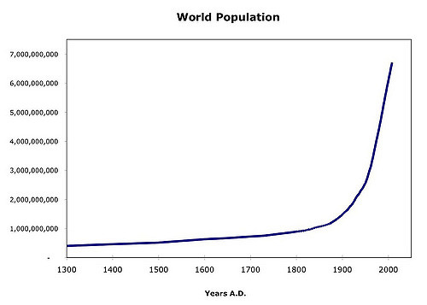
Study the graph of human population growth. Discuss with your table partners possible explanations for the human population growth curve.
Do you think the human population can continue growing in this trend? Why or why not?
https://www.flickr.com/photos/mplemmon/3203403780

Slide 3
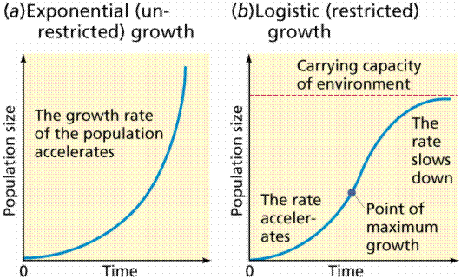
Exponential Vs. Logistic Growth
http://mhsaphuge1.wikispaces.com/Population+%26+Migration

Slide 4
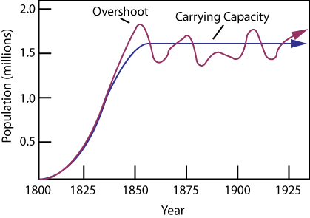
Exponential Growth
The population may fluctuate around the carrying capacity due to interspecific competition or environmental changes.
http://www.algebralab.org/practice/practice.aspx?file=Reading_CarryingCapacity.xml

Slide 5
Manipulatives
With your table partners, place each phrase in the correct location on the graphs.

Slide 6
What are Limiting Factors?
Density – Dependent Limiting Factors
These factors depend on population density.
(Biotic factors)
Density – Independent Limiting Factors
These factors do not depend on population density. (Abiotic factors)
Competition
Predation
Parasitism
Disease
Habitat space
Accumulation of waste
Hurricanes
Tornadoes
Earthquakes
Floods
Temperature
Pollution

Slide 7
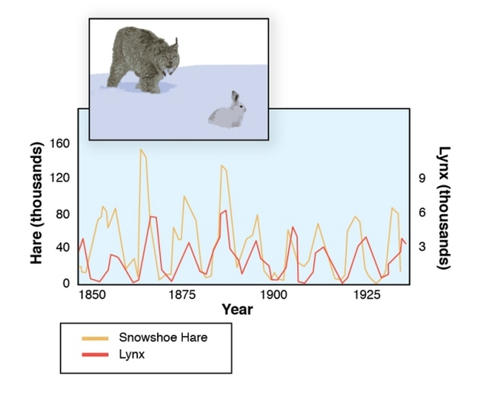
Graph of Predator – Prey Populations

Slide 8
Density Dependent or Independent Game
You are a deer. Work with your shoulder partner to take turns categorizing the cards as density-dependent or density-independent factors. If your partner gets the answer correct, they keep the card. If your partner gets the answer incorrect, you keep the card. However has the most cards at the end wins!

Slide 9
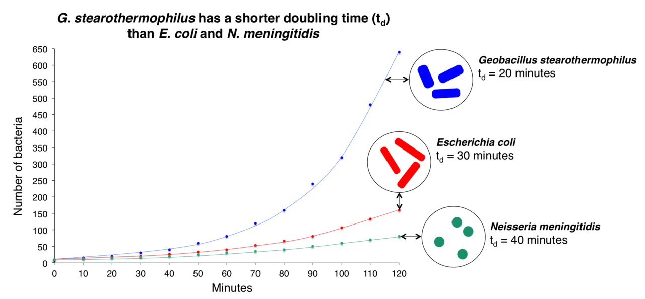
Day 2 Bellwork
https://en.wikipedia.org/wiki/Population_ecology
Which bacteria has the shortest lag phase?
Will these bacterial colonies eventually reach a carrying capacity? Explain your answer.

Slide 10
Logistic Growth in Cells
Logistic growth can be witnessed when culturing cells. Cell culturing involves removing cells from a multicellular eukaryotic organism and growing them in a flask or petri dish with medium and other favorable environmental conditions, such as temperature and CO₂ levels. Eventually, cells will reproduce enough that they will reach their carrying capacity. Before this happens, cells should be passaged.
Cell passaging involves transferring some of the cells from the original flask to a new flask once the cells have reached 80-100% confluence. This is important for a few reasons: so that there are fresh nutrients in the new media, to avoid a buildup of toxic metabolites and to avoid contact inhibition by giving the cells more room for them to grow.

Slide 11
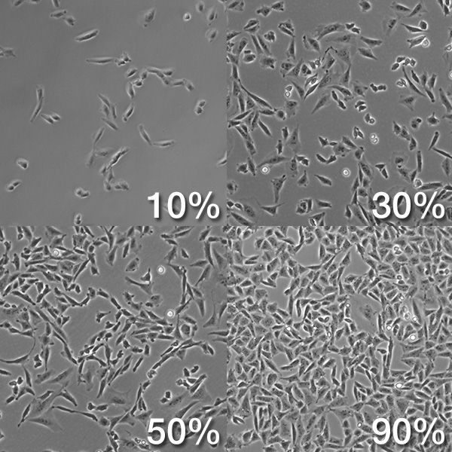
Cell Confluency
The bright, round cells are unattached.
The long, spindle-shaped cells are attached. These are adherent cells.
Passage cells when 80 – 100% confluent.
http://biology.stackexchange.com/questions/29857/what-does-confluency-mean

Slide 12
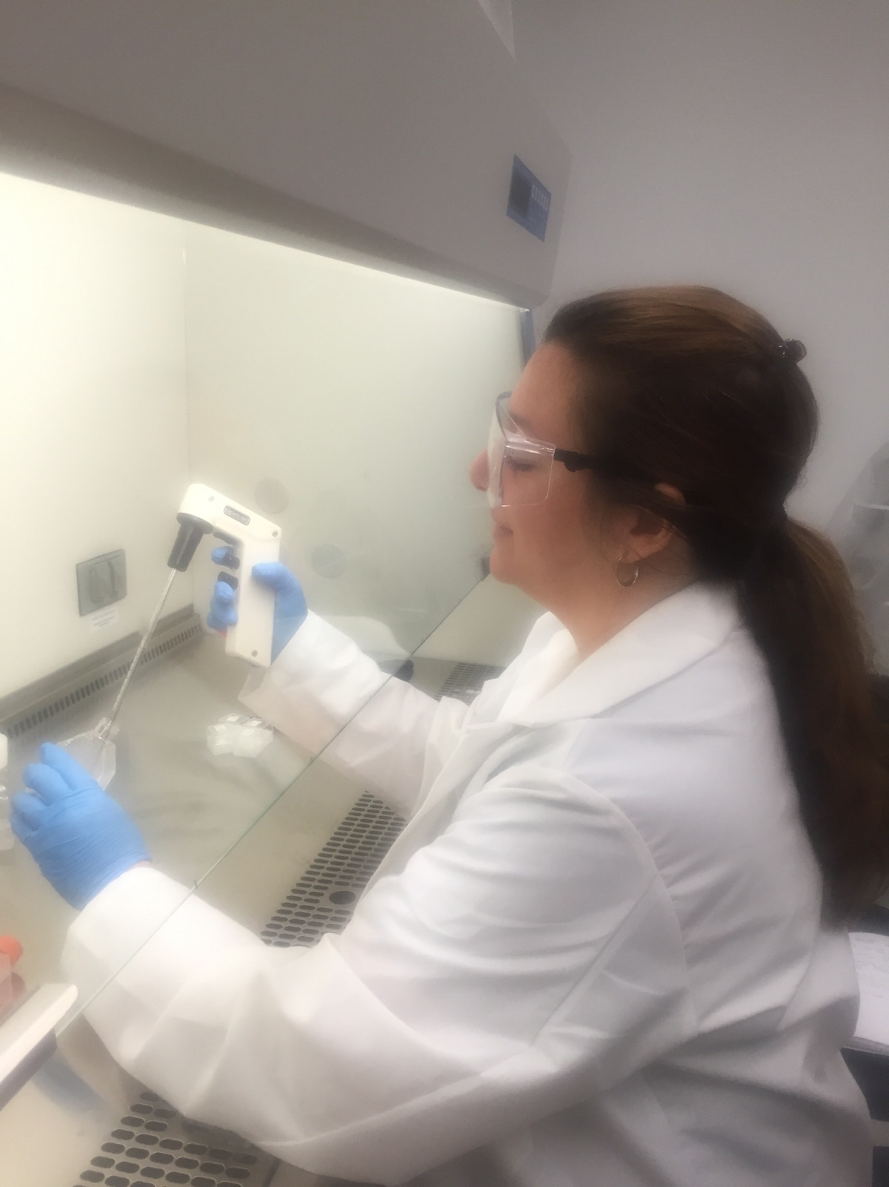
Aseptic Technique
Cell culturing and cell passaging must be performed with aseptic technique. Aseptic technique is a method to perform laboratory procedures in such a way as to avoid microbial contamination. Sterile gloves are worn. The biosafety hood and all equipment that goes inside is sprayed with 70% ethanol or 70% isopropyl alcohol. Movement of people, and thus air, is limited in the work area. Lids are kept on all containers until needed. Hands are not placed above open containers. Tips of pipettes must not touch the necks of the bottles or flasks.

Slide 13
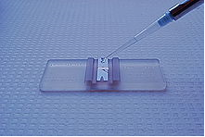
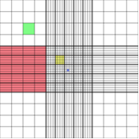
Cell Counting
Cell counting is performed using a hemocytometer in order to determine your total cell count, cell/mL, or percent viability. A hemocytometer is a slide that contains grids of 9 squares on each side of the slide. Each large square is 1 mm². Usually, when looking at one set of 9 squares, the four large corner squares and the large center square is used for counting live and dead cells. 200 total cells should be counted for your data to be statistically significant. Therefore, you may need to count all 18 squares on the hemocytometer if necessary. To visualize the cells, they must first be dyed using Trypan blue. Living cells will appear clear since the dye does not penetrate the cell membrane of living cells. The dye will penetrate the cell membrane of dead cells, making them appear blue.
https://en.wikipedia.org/wiki/Hemocytometer

Slide 14
Edvotek Lab
Let’s read over the lab that we will perform. The purpose of this lab is for your to learn how to culture, passage and count cells so that you have data to graph on a real life example of a population that experiences logistic growth. This lab will teach you skills that real scientists use when performing research on cell growth and viability.
For the Edvotek lab: http://www.edvotek.com/1001
For the Edvotek lab instructions: http://www.edvotek.com/site/pdf/1001.pdf

Slide 15
JOVE Video on Cell Passaging
10 minute video on cell passaging: http://www.jove.com/science-education/5052/passaging-cells

Slide 16
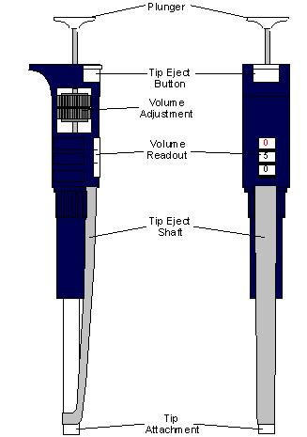
Micropipette Practice
Adjust the volume to the desired amount
Place a disposable tip on the tip attachment
Press plunger down to the first stop
Place the pipette into the solution to be
aspirated.
5. Lift up on plunger to aspirate the liquid
6. Place the pipette into the new container
7. Place plunger all the way down, past the first
stop and to the second stop.
8. Keep the plunger down as you remove it from
the container.
9. Hit the tip eject button while over the waste
container to eject the tip into the waste.
http://www.di.uq.edu.au/sparqmicropipette

Slide 17
Day 3 Perform the Edvotek Lab
Take out your Eukaryotic Cell Biology lab packet.
Today we will:
View the cells in the flasks
Passage the cells
Count the cells
Complete the lab packet questions.

Slide 18
Day 4 Bellwork
Follow the procedures form yesterday to count your cells. You will need to count your cells each day for Bellwork until they reach their carrying capacity. Then you will create a logistic growth curve for your cells and turn this in for a grade.

Slide 19
Why is the AMBIR lab at USF growing these cells?
Cells are being cultured on nanofiber membranes to be used as tissue scaffolds for wound healing. The nanofiber membranes are created through a process of electrospinning.

Slide 20
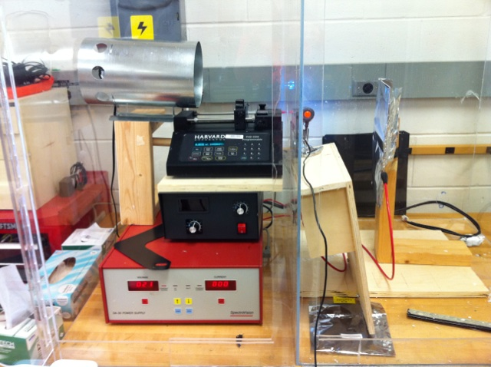
What is Electrospinning?
Electrospinning involves placing a polymer solution into a syringe to which an electric field is then applied, usually about 20 kV, which overcomes the surface tension of the polymer solution. A polymer jet is then ejected from the syringe needle tip, undergoes plastic stretching, and is deposited onto the collector as extremely thin fibers that range in diameter from nanometers to a few microns[1].
Light Source
Infusion Pump
Syringe
Grounded
Collector of
Aluminum
Foil
High
Voltage
Power Supply

Slide 21
Demo on Electrospinning
Electrospinning Demo

Slide 22
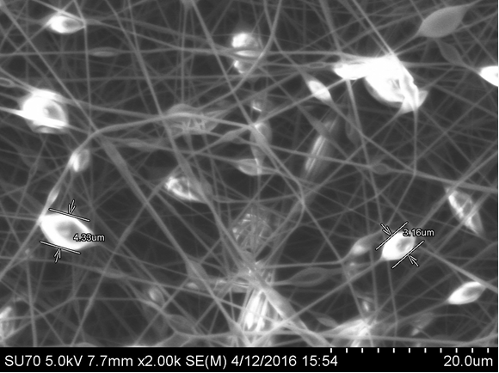
Polystyrene Nanofibers with Cactus Mucilage
Research performed at USF shows that cactus mucilage increases cell proliferation.
These are functional materials because different additives give the nanofibers different functions.

Slide 23
Let’s Make Fibers!
Dissolve the polystyrene into the d-Limonene until you have a viscous solution.
Wearing gloves, rub your hands together and then clap to create fibers.

Slide 24
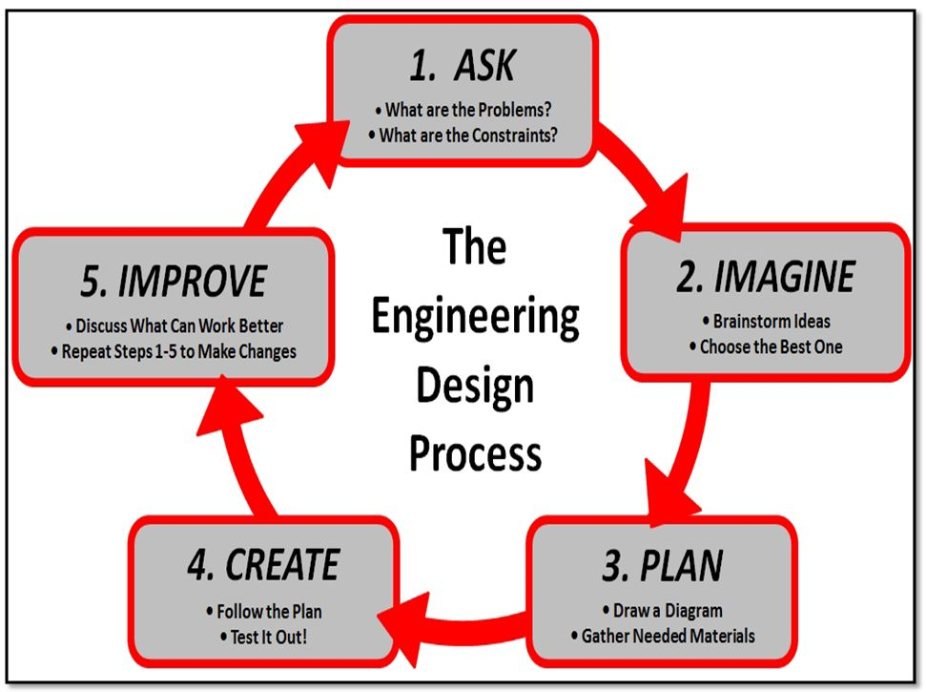
https://cromwellvalleyes.bcps.org/event_highlights/steam

Slide 25
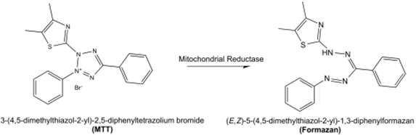
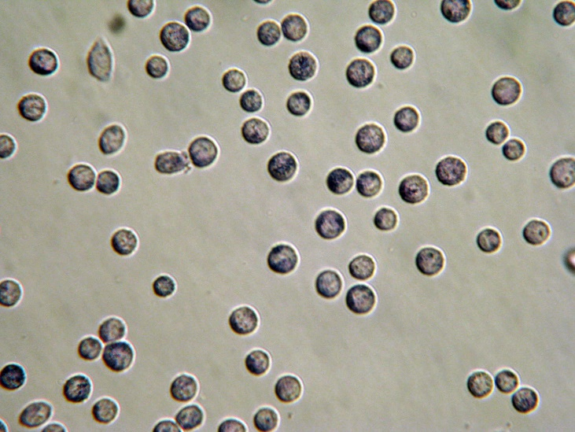
Testing Cell Growth on the Scaffolds with an MTT Assay
When testing a variable on cell viability or proliferation, an MTT assay can be performed. Mitochondrial enzymes in metabolically active cells cleave the yellow tetrazolium salt MTT (3-(4, 5-dimethylthiazolyl-2)-2, 5-diphenyltetrazolium bromide) forming an intracellular purple punctate precipitate named formazan.
https://en.wikipedia.org/wiki/MTT_assay

Slide 26
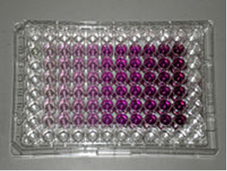
Dimethyl sulfoxide (DMSO) dissolves formazan into a colored solution, which can be quantified by a spectrophotometer. The more purple the solution, the greater the absorbance and the greater the number of cells.
https://en.wikipedia.org/wiki/MTT_assay

Slide 27
Video of Tissue Scaffolding
2:13 video on lab grown human organs for transplant https://www.youtube.com/watch?v=bdLL0a79CsI

Slide 28
Extension of Lab
With your group, determine a variable that you would like to manipulate in your Eukaryotic Cell Biology Lab to test its effect on cell growth. You must create another growth curve and compare it to the original growth curve.
Some options could be:
a. The effect of temperature on cell growth.
b. The effect of CO2 levels on cell growth
c. The effect of pH on cell growth.
d. The effect of a substance on your cell culture.

Slide 29
Extension
Research real life situations of polymers used in tissue engineering. Report on
- what type of tissue or organ was created
- the properties of the polymers that make them an appropriate choice for use as a tissue scaffold
- the necessary characteristics of a tissue scaffold that allow cell growth and proliferation.
- obstacles that must be overcome to perform electrospinning on a large scale for industry purposes.

